Slide 1
CPS 109 - Lab 2

Slide 2
Agenda
1 - Housekeeping
2 - Recap of Last Week
3 - Operators
4 - Loops

Slide 3
Recap of Last Week
Remember last week we went over a lot of new stuff! Not remembering all of it is completely fine.
I would recommend rereading if/elif/else

Slide 4
Recap of Last Week
Let’s talk about this statement:
What is this line, exactly? In short, this tells the computer what code to execute when the main file in a program is run.

Slide 5
Operators
Operators are, in essence, the backbone of programming. They’re instructions that the computer recognizes and uses to manipulate or check data.
Anything from boolean comparisons, to mathematical operations, to comparisons.

Slide 6
Introduction to Loops
Do you want to repeat a bunch of code until you achieve something specific? Maybe until you reach a certain number of iterations or you find what you’re looking for in a list?
You need a loop for that.

Slide 7
Introduction to Loops
What is a loop?
A loop is a certain set of instructions (syntax) that the computer knows to repeat until a condition is met.
Kinds of loops: while, for, nested

Slide 8
Loops: For
A for loop will repeat a specific set of instructions (written by you) for the amount of time/number of iterations specified.
Simply put: the computer will do something x amount of times.

Slide 9
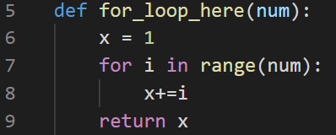
Loops: For

Slide 10
Loops: While
A while loop will follow a set of instructions while its boolean condition isn’t met.
Simply put: the computer will do x instructions until y is true.

Slide 11
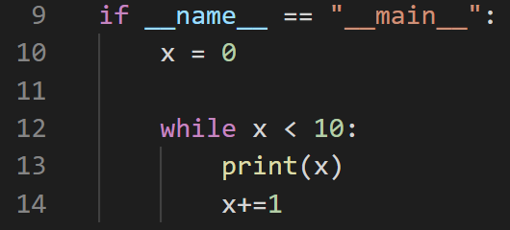
Loops: While

Slide 12
Loops: Nested
Nesting a loop is just a fancy way of saying putting a loop inside of another loop.
You can do this as many times as you like as long as you don’t care about your computer catching fire.

Slide 13
Loops: Nested
You can put a for loop within a for loop, a while loop within a while loop.
You can also get really spicy and put a for loop in a while loop, or a while loop in a for loop.

Slide 14
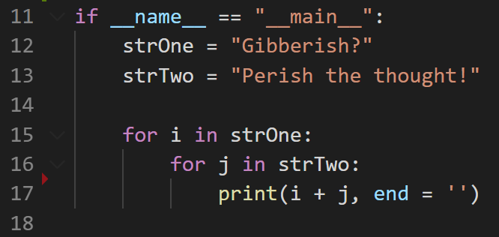
Loops: Nested

